Slide 1



Slide 2

Punch Boxing 3D
Supervised by:
Sir Shahzad Rizwan
Group Members:
Mudassir ( FA16-BCS-025)
Presented on July, 2020
Department of Computer Science
COMSATS University Islamabad
Attock Campus

Slide 3
Outline
_______________________________
Introduction
Problem statement
Related Work / Applications
Objectives
Methodology
Tools and Technologies
Benefits
User Interface
DFD
Use Case Diagram
Activity Diagram
Sequence Diagram

Slide 4
Introduction
Video Gaming is something which is played by electronics manipulating images produced by a computer programes.
Playing video games sometimes fulfills our purposes in life and This could include gaming for: relaxation, opportunities to exert control, enjoyment, creativity, socialization, prevent boredom, challenge, and achievement

Slide 5
Intro Continued
Gaming Industry is consider one of the biggest Entertainment industry nows days, According to the latest figures, the video game business is now larger than both the movie and music industries combined.
I developed my Gaming Project(Punch Boxing 3D) with help of Unity platform.
Unity gaming engine is completely free of cost and it is pretty much capable of making quality 3D games.

Slide 6
Intro Continued
My project is a boxing game with Voice recognition system which makes it more unique and fun to play.
First of all the user can play this game with help of keyboard default commands like any other game.
IF user want to play the game by voice recognition then user have to click on sound on button so that voice commands will start working .
user can play game in both ways mean Voice+keys at the same time.

Slide 7
Problem Statement
There are a lot of fighting game available for the user to play but none of them gives dual controls in the game.
The purpose of my project is to introduce a new concept of voice recognition to the fighting game.
Voice recognition will allow and attract much more audience to video games.

Slide 8
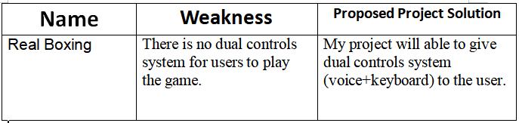
Related Work / Games

Slide 9
Objectives
The main aims and objectives of our system are
as under :-
To built a complete game and add unique concepts for the players.
To understand the gaming Unity tool.
To provide user a better experience and new ways to play and interact with the game.
To provide Refreshment and Entertainment.

Slide 10
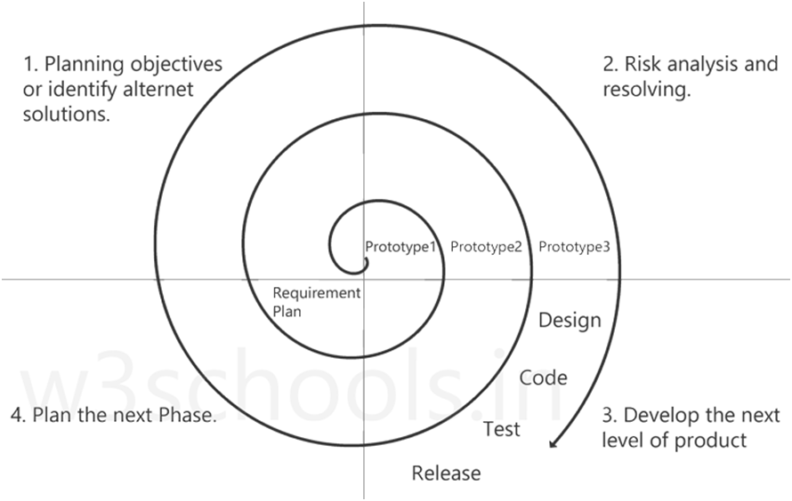
Methodology
Project is design to build in Spiral model.
It is a Game development life cycle model where project/Game is designed, built and tested according to spiral model.

Slide 11
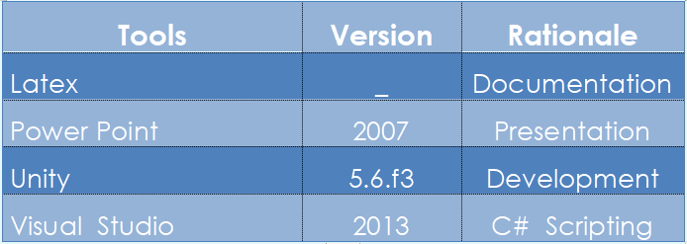
Tools and Technologies

Slide 12
Benefits
Players can use the keyboard and voice commands to play our games.
Voice commands in the fighting games is something,which is vey much new to the regular players which makes our game more interesting to play.
Voice commands in the our game will allow disable user to play as well.

Slide 13
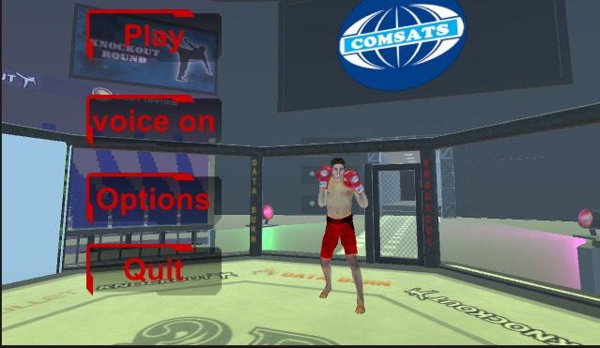
User Interfaces(Main Panel)

Slide 14
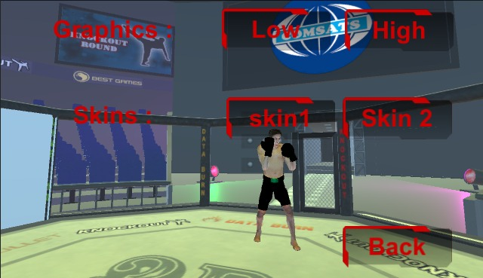
Option(UI)

Slide 15
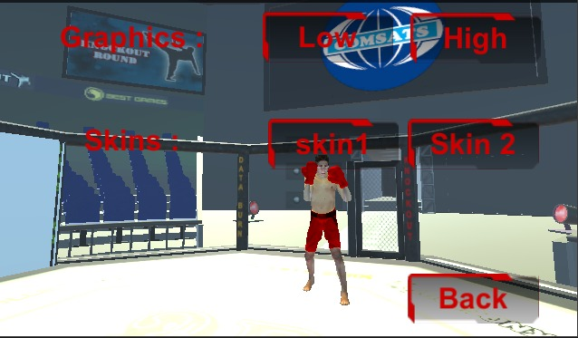
Graphics(Low)

Slide 16
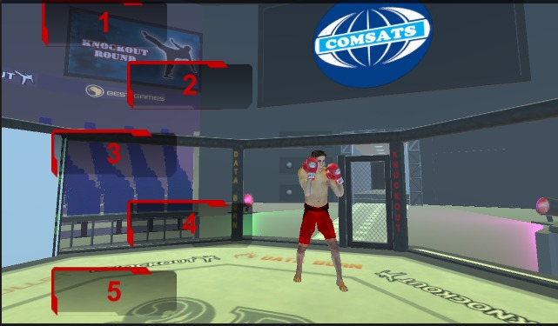
Levels Selection

Slide 17
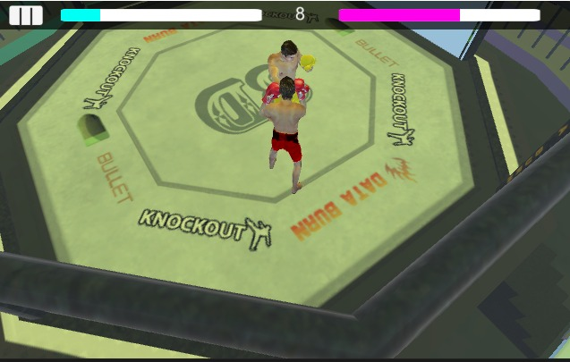
GamePlay

Slide 18
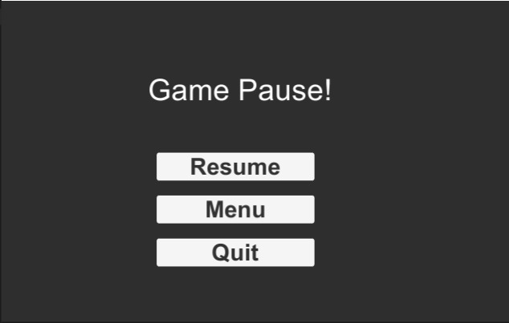
Game Pause

Slide 19
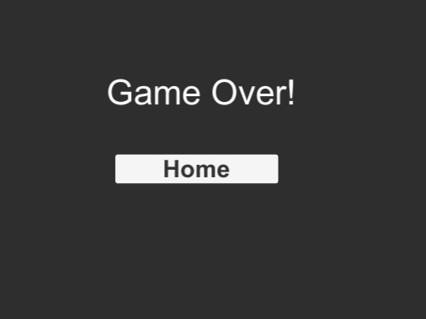
Game Over

Slide 20
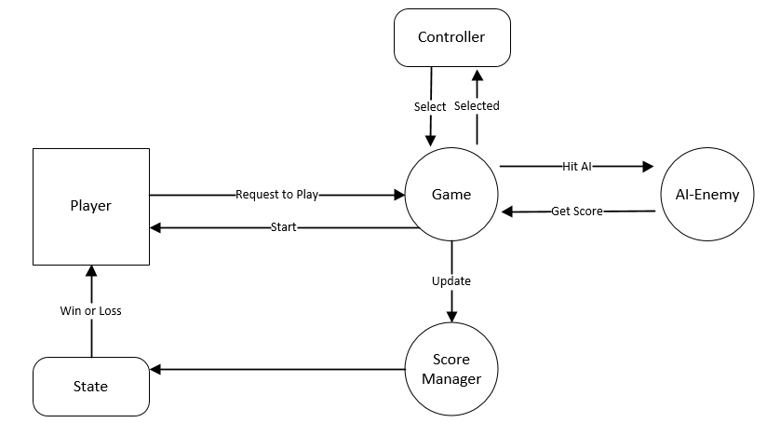
Data Flow Diagram

Slide 21
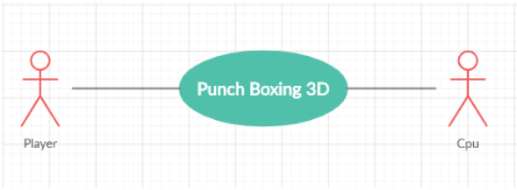
Use Case Diagram Level 0

Slide 22
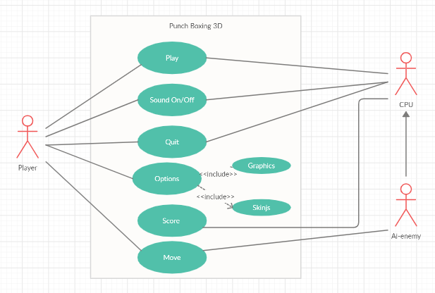
Use Case Diagram

Slide 23
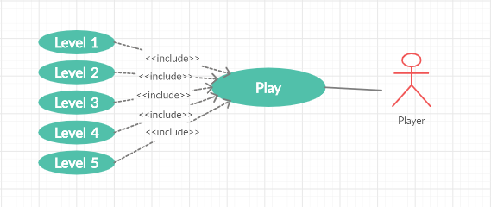
Use Case Diagram

Slide 24
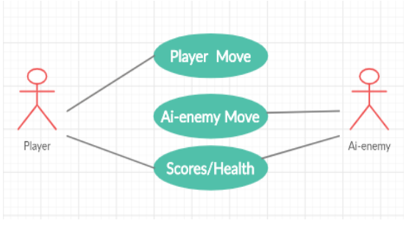
Use Case Diagram

Slide 25
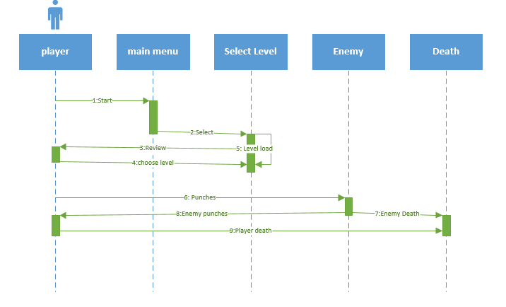
Activity Diagram

Slide 26
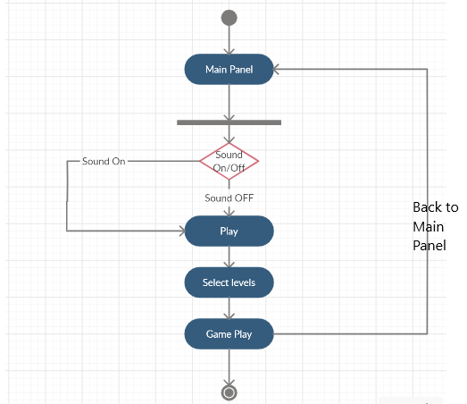
Sequence Diagram

Slide 27


